Slide 1

The Biblical Terminology for Salvation
Soteriology: God's Rescue Program
Dr. Rick Griffith • Jordan Evangelical Theological Seminary • BibleStudyDownloads.org

Slide 2

Salvation in the OT

Slide 3
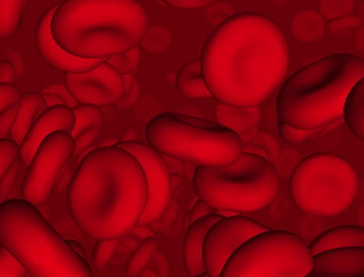
Why did God institute the sacrificial system?
Did the blood actually forgive sin?

Slide 4
Did blood sacrifices save Israelites under the Law?
BLOOD

Slide 5
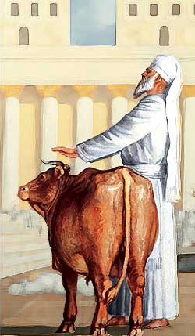
Sacrifices forgave sin
"Through this process, the priest will purify the people, making them right with the LORD, and
they will be forgiven"
(4:20 NLT; cf. 4:26, 31, 35).

Slide 6

Which is the Most Accurate?
121a
Salvation by…
Faith + Works
Faith Alone
Faith + Works
OT
Works
Faith Alone
Faith Alone
Faith + Works
NT
Faith
• Which verses in the Bible support your answer?
cf. OTS 119e
Notes:
Did God change the means of salvation from the OT to the NT?
We are NOT talking about whether people should do good works—we all agree on that. But are works needed for salvation?
Paul answers this question in Romans 4 with the example of Abraham who was saved by faith alone—see Gen 15:6.
________
BE-03-Lev-27
OB-37-Sacrifices-72_eng_ob_1667_v5—slide 17
OB-39-Salvation-2
OS-03-Leviticus-13
OP-03-Lev-27
OP-Lev_6v24-7v10 Why All That Blood Sin & Guilt Offerings-49_eng_op_v4.0—slide 34
OS-04-Num-27
NP-Acts_15v1-35_Dont_Be_Law_Abiding_(Rick_Griffith)-61_eng_pr_v4—slide 5
NS-05-Acts15-16-slide 26
NS-Rom3-4-slide 77
NS-09-Galatians-48
NS-20-James-30
NS-23-1Jn-58
SA-03-Biblical Terms-6
SA-15-Inheritance-26

Slide 7
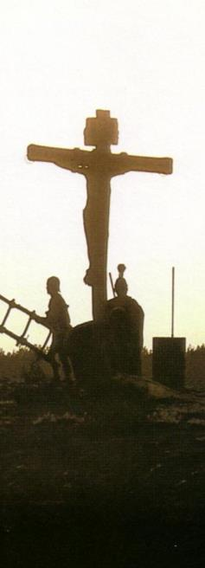
Salvation in All Ages:
The Centrality of the Cross
B.C.
They looked forward to the Cross of Christ
A.D.
We look
back at the Cross of Christ
Notes:
The grounds of salvation has always been the death of Christ—for believers before and after the cross.
____________________
Common English-78
OB-37-Sacrifices-19
OB-38-Salvation-4
OS-03-Leviticus-73
NS-09-Galatians-50
NS-20-James-32
SA-03-Biblical Terminology-10
SA-15-Inheritance-26

Slide 8
Salvation & Sanctification
121a
Man's Role
God's Response
Life of Faith
Restored Fellowship
Faith in God as offered Passover Lamb
Journey to Canaan
Sacrifices
(Sin, Guilt)
OT
Exodus
Type
|
Antitype
Type
|
Antitype
Type
|
Antitype
Type
|
Antitype
Faith in Christ as Lamb of God (1 Cor. 5:7)
Salvation
(1 Cor. 10:1-4)
Growth
(1 Cor. 10:5)
Confession
(1 John 1:9)
NT
Positional Sanctification
Progressive Sanctification
Notes:
The OT plan of salvation is mirrored in the NT—both by simple faith in the Lamb pictured in the Passover.
Exodus from Egypt is a type of the believer who leaves his slavery to sin—all believers in the Lamb are saved, including all Israelites who left Egypt as they demonstrated that faith by putting the blood on the doorposts of their homes (=positional sanctification).
But both OT and NT believers must live a life of faith in God, pictured in Israel’s journey to Canaan and mirrored in the Christian’s growth or progressive sanctification.
Finally, as OT believers confessed their ongoing sins in the sin and guilt sacrifices (for restoring fellowship with God—NOT for salvation!), so NT believers confess sins even after they are saved to restore their fellowship (NOT relationship!) with God.
_________
Common English-78
OB-37-Sacrifices-18
OS-00-Book Overviews-73
OS-04-Numbers-13
NS-09-Galatians-49
NS-20-James-31
SA-03-Biblical Terms-7
SA-15-Inheritance-26

Slide 9

OT Forgiveness of Sin
121b
Pipe = Relationship with God (never changing)
Sin
Clog = Fellowship with God (hindered by sin)
Sacrifices = Confession of Sin (sin forgiven to restore fellowship but relationship was never threatened)
Notes:
Do we still have a relationship with God when we sin? Yes!
Sin does not hinder our relationship with God but our fellowship with Him.
OT sacrifices did not establish a relationship with God but rather they restored their fellowship with God
________
OS-03-Leviticus-14
OS-04-Num-29
OP-02-Lev-28
NS-23-1Jn-58
SA-03-Biblical Terms-9
SA-15-Inheritance-27

Slide 10
NT Forgiveness of Sin
121b
"If we confess our sins,
He is faithful and righteous to forgive us our sins and to cleanse us from all unrighteousness"
(1 John 1:9 NAU)
Pipe = Relationship with God (never changing)
Sin
Clog = Fellowship with God (hindered by sin)
Christ's Sacrifice = The Basis for Confession of Sin (sin is forgiven to restore fellowship but relationship has never been never threatened)
Notes:
Our relationship with God can be compared to a pipe.
Occasionally the pipe gets a clog—like sin—that hinders our fellowship with God.
Do we still have a relationship with God when we sin? Yes!
Sin does not hinder our relationship with God but our fellowship with Him.
_________
OB-38-Salvation-11
OS-03-Leviticus-56, 72, 130
OS-04-Numbers-30
NS-23-1Jn-59
SA-03-Biblical Terms-9
SA-15-Inheritance-28

Slide 11
Salvation in the Old Testament
22
119e
OT Times
(Moses to Christ's Death)
NT Times
(Christ's Death to Today)
Basis
of Salvation
God's gracious provision of the death of Christ ("it is the blood that makes atonement for one's life,"
Lev. 17:11b)
God's gracious provision of the death of Christ ("without the shedding of blood there is no forgiveness," Heb. 9:22)
Requirement
of Salvation
Faith in the provision that God has revealed–as a gift (Ps. 51:16-17)
Faith in the provision that God has revealed–as a gift (Gal. 2:16)
Ultimate Content
of Salvation
Object of faith is God Himself–prophets exhorted repentance, not sacrifices (Jer. 3:12)
Object of faith is God Himself–heroes of faith are cited to exhort faith in God (Heb. 11)
Specific
Revealed Content
of Salvation
Cumulative content of faith had sacrifices & promises: animals (Gen. 3:21), Abel's sacrifice (Gen. 4:4), Abrahamic covenant (Gen. 15)
New content of faith is the shed blood of Jesus Christ (1 Pet. 1:18-21) which removes sin (cp. OT sacrifices merely covered sin)
Believer's Expression
of Salvation
Obey moral law, offer animal sacrifices, obey Mosaic law (civil
and ceremonial aspects)
Obey moral law, observe Lord's Supper and baptism, etc. through the Spirit's enabling (Rom. 8:9)

Slide 12
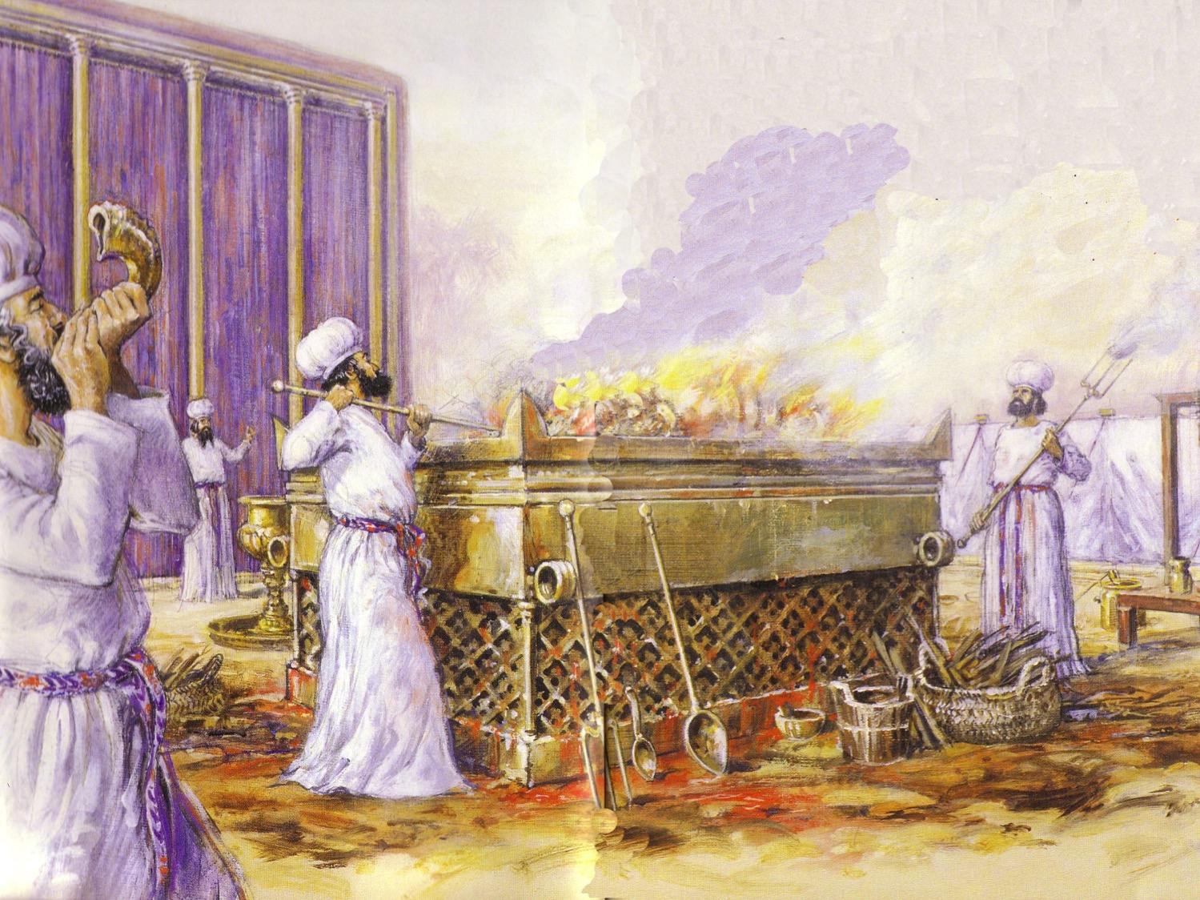
Leviticus Synthesis
124
Sanctification through sacrifice and separation
1–10 Sacrifice
(worshipping God)
11–27 Separation
(walking with God)

Slide 13
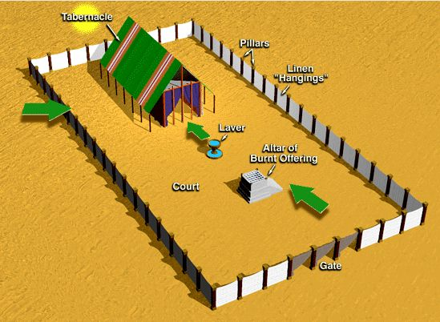
Offerings in Leviticus 1–7
128
Whole burnt offering
Grain offering
Fellowship offering
Sin offering
Guilt offering
Consecration
Voluntary
Cleansing
Obligatory

Slide 14
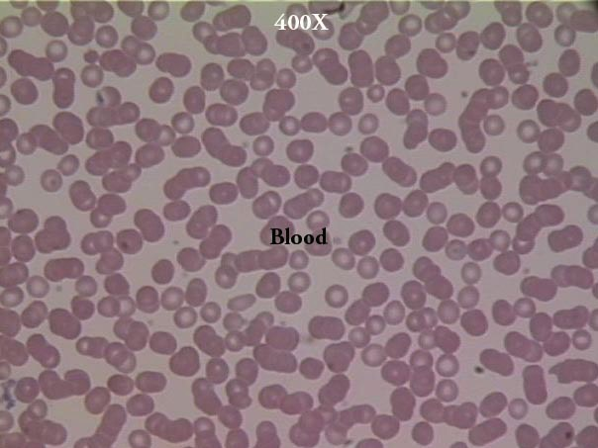
Blood?
127a
What's the Significance of
"In fact, the law requires that nearly everything be cleansed with blood, and without the shedding of blood there is no forgiveness" (Heb. 9:22 NIV)

Slide 15
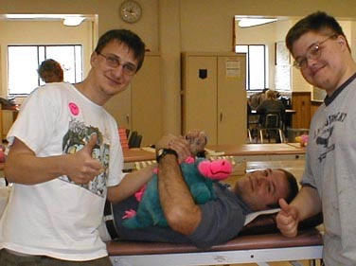
"The life is in the blood"
127a
"For the life of a creature is in the blood, and I have given it to you to make atonement for yourselves on the altar; it is the blood that makes atonement for one's life" (Lev. 17:11)

Slide 16
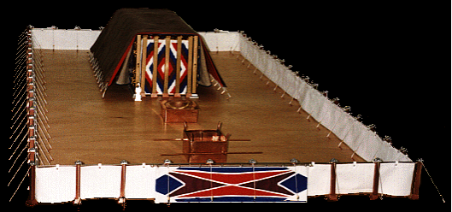
For a great online tabernacle survey go to:
http://www.domini.org/tabern/tabhome.htm

Slide 17
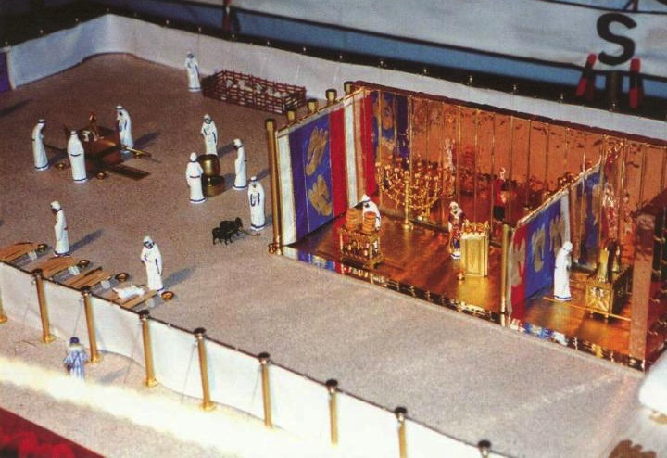
Day of Atonement (Lev. 16:29-34)
Courtyard
Holy Place
Holy of Holies

Slide 18
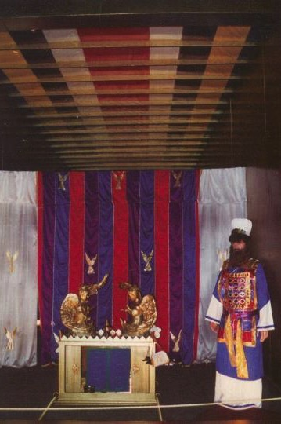
Day of Atonement
Priest's preparation
Priest's sin offering
People's sin offering
Scapegoat
Cleansing
Leviticus 16:29-34

Slide 19
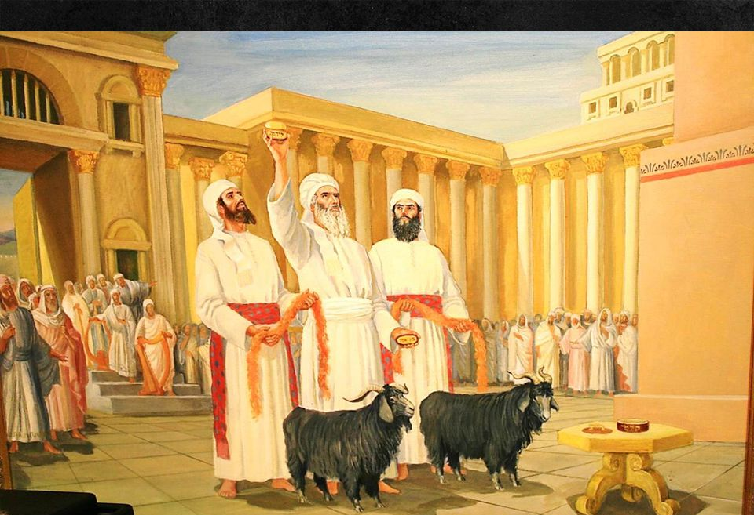
"Then he must take the two male goats and present them to the Lord at the entrance of the Tabernacle. 8 He is to cast sacred lots to determine which goat will be reserved as an offering to the Lord and which will carry the sins of the people to the wilderness of Azazel" (Leviticus 16:7-8 NLT).

Slide 20
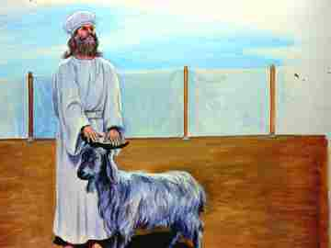
"Aaron will then present as a sin offering the goat chosen by lot for the LORD"
(Leviticus 16:9 NLT).

Slide 21
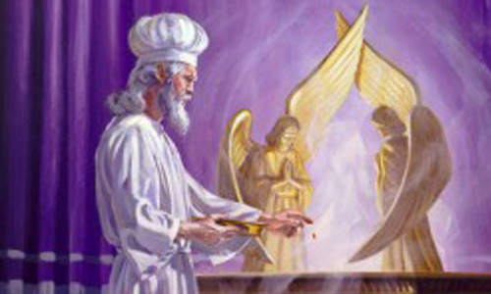
"Then Aaron must slaughter the first goat as a sin offering for the people and carry its blood behind the inner curtain. There he will sprinkle the goat's blood over the atonement cover and in front of it, just as he did with the bull's blood"
(Leviticus 16:15 NLT).

Slide 22
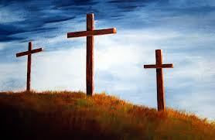
Salvation in the NT
23

Slide 23

How are the Terms Used in the NT?
23
Salvation
The following lists the uses of the noun "salvation" (Gk. sōteria) and the verb "save" (Gk. sōzō) in Vine's Complete Expository Dictionary under "Save, Saving"
Notes:
It's possible to believe in Jesus but not be saved…
By Jeremy Myers (BA at MBI, ThM in BE at DTS)
https://redeeminggod.com/believe-in-jesus-but-not-be-saved/
Posted in 2014
Accessed 9 May 2016
13 Comments
Like the word "gospel," the word "salvation" means much more and much less than usually assumed.
Just like the word "gospel," the way the word "salvation" is often used today is very different from the way the word is used in Scripture.
When people talk about "salvation" today or "being saved," what they most often have in mind is the idea of receiving the forgiveness of sins so we can escape hell and go to heaven when we die.
But in biblical usage, the noun "salvation" (Gk., sōteria) and the verb "save" (Gk., sōzō) very rarely have anything to do with receiving eternal life or going to heaven when we die. Instead, the words are most often used in connection with some sort of temporal or physical deliverance. We can be saved from enemies, saved from sickness, saved from drowning, saved from suffering, or even saved from a premature physical death. While "salvation" is sometimes used in connection with sin, this is only because sin often has devastating physical and temporal consequences in our life. To be saved from sin means to be delivered from the destruction and damage of sin in our lives.
One resource that shows this quite clearly is Vine's Complete Expository Dictionary. Under the entry for "Save, Saving," the dictionary includes the following options:
(a) Of material and temporal deliverance from danger, suffering, etc., e.g., Matt 8:25; Mark 13:20; Luke 23:35; John 12:27; 1 Tim 2:15; 2 Tim 4:18; Jude 5; from sickness, Matt 9:22; so Mark 5:34; Luke 8:48; Jas 5:15
(b) Of the spiritual and eternal salvation granted immediately by God to those who believe on the Lord Jesus Christ, e.g., Acts 2:47, 16:31; Rom 8:24; Eph 2:5, 8; 1 Tim 2:4; 2 Tim 1:9; Titus 3:5; of human agency in this, Rom 11:4; 1 Cor 7:16; 9:22
(c) Of the present experiences of God's power to deliver from the bondage of sin, e.g., Matt 1:21; Rom 5:10; 1 Cor 15:2; Heb 7:25; Jas 1:21; 1 Pet 3:21; of human agency in this, 1 Tim 4:16
(d) Of the future deliverance of believers at the second coming of Christ for his saints, being deliverance from the wrath of God to be executed upon the ungodly at the close of this age and from eternal doom, e.g., Rom 5:9
(e) Of the deliverance of the nation of Israel at the second advent of Christ, e.g., Rom 11:26
(f) Inclusively for all the blessings bestowed by God on men in Christ, e.g., Luke 19:10; John 10:9; 1 Cor 10:33; 1 Tim 1:15
(g) Of those who endure to the end of the time of the Great Tribulation, Matt 10:22; Mark 13:13
(h) Of the individual believer, who, though losing reward at the judgment seat of Christ hereafter, will not lose his salvation, 1 Cor 3:15; 5:5
(i) Of the deliverance of the nations at the Millennium, Rev 21:24
Though I would not state this list of various definitions quite this same way, and would put many of the references from definition (b) into other categories, it nevertheless shows that the words "save" and "salvation" in the Bible have a wide variety of meanings.
To help the reader of Scripture know what sort of "salvation" is in view when they are studying it, I recommend that whenever you comes across the words "save" or "salvation" in Scripture, you stop, replace it mentally with the word "deliver" or "deliverance" and then ask yourself, "Deliverance from what?" If you look in the surrounding context, you will quickly discover that the deliverance in view has nothing to do with gaining eternal life or going to heaven when you die.
Doing this will drastically help your understanding of numerous difficult passages in the Bible that many have thought of as referring to receiving eternal life, but refer instead to some sort of temporal deliverance.
It is possible, as the title of this post says, to believe in Jesus for eternal life (and of course, receive eternal life as a result), but still not be "saved" from many of the temporal and physical consequences of sin, or from sickness, or from enemies, or from many of the other negative things that can happen in life.

Slide 24
How are the Terms Used in the NT?
23
(a) Of material and temporal deliverance from danger, suffering, etc., e.g., Matt 8:25; Mark 13:20; Luke 23:35; John 12:27; 1 Tim 2:15; 2 Tim 4:18; Jude 5; from sickness, Matt 9:22; so Mark 5:34; Luke 8:48; Jas 5:15
(b) Of the spiritual and eternal salvation granted immediately by God to those who believe on the Lord Jesus Christ, e.g., Acts 2:47, 16:31; Rom 8:24; Eph 2:5, 8; 1 Tim 2:4; 2 Tim 1:9; Titus 3:5; of human agency in this, Rom 11:4; 1 Cor 7:16; 9:22
(c) Of the present experiences of God's power to deliver from the bondage of sin, e.g., Matt 1:21; Rom 5:10; 1 Cor 15:2; Heb 7:25; Jas 1:21; 1 Pet 3:21; of human agency in this, 1 Tim 4:16
Notes:
It's possible to believe in Jesus but not be saved…
By Jeremy Myers (BA at MBI, ThM in BE at DTS)
https://redeeminggod.com/believe-in-jesus-but-not-be-saved/
Posted in 2014
Accessed 9 May 2016
13 Comments
Like the word "gospel," the word "salvation" means much more and much less than usually assumed.
Just like the word "gospel," the way the word "salvation" is often used today is very different from the way the word is used in Scripture.
When people talk about "salvation" today or "being saved," what they most often have in mind is the idea of receiving the forgiveness of sins so we can escape hell and go to heaven when we die.
But in biblical usage, the noun "salvation" (Gk., sōteria) and the verb "save" (Gk., sōzō) very rarely have anything to do with receiving eternal life or going to heaven when we die. Instead, the words are most often used in connection with some sort of temporal or physical deliverance. We can be saved from enemies, saved from sickness, saved from drowning, saved from suffering, or even saved from a premature physical death. While "salvation" is sometimes used in connection with sin, this is only because sin often has devastating physical and temporal consequences in our life. To be saved from sin means to be delivered from the destruction and damage of sin in our lives.
One resource that shows this quite clearly is Vine's Complete Expository Dictionary. Under the entry for "Save, Saving," the dictionary includes the following options:
(a) Of material and temporal deliverance from danger, suffering, etc., e.g., Matt 8:25; Mark 13:20; Luke 23:35; John 12:27; 1 Tim 2:15; 2 Tim 4:18; Jude 5; from sickness, Matt 9:22; so Mark 5:34; Luke 8:48; Jas 5:15
(b) Of the spiritual and eternal salvation granted immediately by God to those who believe on the Lord Jesus Christ, e.g., Acts 2:47, 16:31; Rom 8:24; Eph 2:5, 8; 1 Tim 2:4; 2 Tim 1:9; Titus 3:5; of human agency in this, Rom 11:4; 1 Cor 7:16; 9:22
(c) Of the present experiences of God's power to deliver from the bondage of sin, e.g., Matt 1:21; Rom 5:10; 1 Cor 15:2; Heb 7:25; Jas 1:21; 1 Pet 3:21; of human agency in this, 1 Tim 4:16
(d) Of the future deliverance of believers at the second coming of Christ for his saints, being deliverance from the wrath of God to be executed upon the ungodly at the close of this age and from eternal doom, e.g., Rom 5:9
(e) Of the deliverance of the nation of Israel at the second advent of Christ, e.g., Rom 11:26
(f) Inclusively for all the blessings bestowed by God on men in Christ, e.g., Luke 19:10; John 10:9; 1 Cor 10:33; 1 Tim 1:15
(g) Of those who endure to the end of the time of the Great Tribulation, Matt 10:22; Mark 13:13
(h) Of the individual believer, who, though losing reward at the judgment seat of Christ hereafter, will not lose his salvation, 1 Cor 3:15; 5:5
(i) Of the deliverance of the nations at the Millennium, Rev 21:24
Though I would not state this list of various definitions quite this same way, and would put many of the references from definition (b) into other categories, it nevertheless shows that the words "save" and "salvation" in the Bible have a wide variety of meanings.
To help the reader of Scripture know what sort of "salvation" is in view when they are studying it, I recommend that whenever you comes across the words "save" or "salvation" in Scripture, you stop, replace it mentally with the word "deliver" or "deliverance" and then ask yourself, "Deliverance from what?" If you look in the surrounding context, you will quickly discover that the deliverance in view has nothing to do with gaining eternal life or going to heaven when you die.
Doing this will drastically help your understanding of numerous difficult passages in the Bible that many have thought of as referring to receiving eternal life, but refer instead to some sort of temporal deliverance.
It is possible, as the title of this post says, to believe in Jesus for eternal life (and of course, receive eternal life as a result), but still not be "saved" from many of the temporal and physical consequences of sin, or from sickness, or from enemies, or from many of the other negative things that can happen in life.

Slide 25
How are the Terms Used in the NT?
23
(d) Of the future deliverance of believers at the second coming of Christ for his saints, being deliverance from the wrath of God to be executed upon the ungodly at the close of this age and from eternal doom, e.g., Rom 5:9
(e) Of the deliverance of the nation of Israel at the second advent of Christ, e.g., Rom 11:26
(f) Inclusively for all the blessings bestowed by God on men in Christ, e.g., Luke 19:10; John 10:9; 1 Cor 10:33; 1 Tim 1:15
Notes:
It's possible to believe in Jesus but not be saved…
By Jeremy Myers (BA at MBI, ThM in BE at DTS)
https://redeeminggod.com/believe-in-jesus-but-not-be-saved/
Posted in 2014
Accessed 9 May 2016
13 Comments
Like the word "gospel," the word "salvation" means much more and much less than usually assumed.
Just like the word "gospel," the way the word "salvation" is often used today is very different from the way the word is used in Scripture.
When people talk about "salvation" today or "being saved," what they most often have in mind is the idea of receiving the forgiveness of sins so we can escape hell and go to heaven when we die.
But in biblical usage, the noun "salvation" (Gk., sōteria) and the verb "save" (Gk., sōzō) very rarely have anything to do with receiving eternal life or going to heaven when we die. Instead, the words are most often used in connection with some sort of temporal or physical deliverance. We can be saved from enemies, saved from sickness, saved from drowning, saved from suffering, or even saved from a premature physical death. While "salvation" is sometimes used in connection with sin, this is only because sin often has devastating physical and temporal consequences in our life. To be saved from sin means to be delivered from the destruction and damage of sin in our lives.
One resource that shows this quite clearly is Vine's Complete Expository Dictionary. Under the entry for "Save, Saving," the dictionary includes the following options:
(a) Of material and temporal deliverance from danger, suffering, etc., e.g., Matt 8:25; Mark 13:20; Luke 23:35; John 12:27; 1 Tim 2:15; 2 Tim 4:18; Jude 5; from sickness, Matt 9:22; so Mark 5:34; Luke 8:48; Jas 5:15
(b) Of the spiritual and eternal salvation granted immediately by God to those who believe on the Lord Jesus Christ, e.g., Acts 2:47, 16:31; Rom 8:24; Eph 2:5, 8; 1 Tim 2:4; 2 Tim 1:9; Titus 3:5; of human agency in this, Rom 11:4; 1 Cor 7:16; 9:22
(c) Of the present experiences of God's power to deliver from the bondage of sin, e.g., Matt 1:21; Rom 5:10; 1 Cor 15:2; Heb 7:25; Jas 1:21; 1 Pet 3:21; of human agency in this, 1 Tim 4:16
(d) Of the future deliverance of believers at the second coming of Christ for his saints, being deliverance from the wrath of God to be executed upon the ungodly at the close of this age and from eternal doom, e.g., Rom 5:9
(e) Of the deliverance of the nation of Israel at the second advent of Christ, e.g., Rom 11:26
(f) Inclusively for all the blessings bestowed by God on men in Christ, e.g., Luke 19:10; John 10:9; 1 Cor 10:33; 1 Tim 1:15
(g) Of those who endure to the end of the time of the Great Tribulation, Matt 10:22; Mark 13:13
(h) Of the individual believer, who, though losing reward at the judgment seat of Christ hereafter, will not lose his salvation, 1 Cor 3:15; 5:5
(i) Of the deliverance of the nations at the Millennium, Rev 21:24
Though I would not state this list of various definitions quite this same way, and would put many of the references from definition (b) into other categories, it nevertheless shows that the words "save" and "salvation" in the Bible have a wide variety of meanings.
To help the reader of Scripture know what sort of "salvation" is in view when they are studying it, I recommend that whenever you comes across the words "save" or "salvation" in Scripture, you stop, replace it mentally with the word "deliver" or "deliverance" and then ask yourself, "Deliverance from what?" If you look in the surrounding context, you will quickly discover that the deliverance in view has nothing to do with gaining eternal life or going to heaven when you die.
Doing this will drastically help your understanding of numerous difficult passages in the Bible that many have thought of as referring to receiving eternal life, but refer instead to some sort of temporal deliverance.
It is possible, as the title of this post says, to believe in Jesus for eternal life (and of course, receive eternal life as a result), but still not be "saved" from many of the temporal and physical consequences of sin, or from sickness, or from enemies, or from many of the other negative things that can happen in life.

Slide 26
How are the Terms Used in the NT?
23
(g) Of those who endure to the end of the time of the Great Tribulation, Matt 10:22; Mark 13:13
(h) Of the individual believer, who, though losing reward at the judgment seat of Christ hereafter, will not lose his salvation, 1 Cor 3:15; 5:5
(i) Of the deliverance of the nations at the Millennium, Rev 21:24
Notes:
It's possible to believe in Jesus but not be saved…
By Jeremy Myers (BA at MBI, ThM in BE at DTS)
https://redeeminggod.com/believe-in-jesus-but-not-be-saved/
Posted in 2014
Accessed 9 May 2016
13 Comments
Like the word "gospel," the word "salvation" means much more and much less than usually assumed.
Just like the word "gospel," the way the word "salvation" is often used today is very different from the way the word is used in Scripture.
When people talk about "salvation" today or "being saved," what they most often have in mind is the idea of receiving the forgiveness of sins so we can escape hell and go to heaven when we die.
But in biblical usage, the noun "salvation" (Gk., sōteria) and the verb "save" (Gk., sōzō) very rarely have anything to do with receiving eternal life or going to heaven when we die. Instead, the words are most often used in connection with some sort of temporal or physical deliverance. We can be saved from enemies, saved from sickness, saved from drowning, saved from suffering, or even saved from a premature physical death. While "salvation" is sometimes used in connection with sin, this is only because sin often has devastating physical and temporal consequences in our life. To be saved from sin means to be delivered from the destruction and damage of sin in our lives.
One resource that shows this quite clearly is Vine's Complete Expository Dictionary. Under the entry for "Save, Saving," the dictionary includes the following options:
(a) Of material and temporal deliverance from danger, suffering, etc., e.g., Matt 8:25; Mark 13:20; Luke 23:35; John 12:27; 1 Tim 2:15; 2 Tim 4:18; Jude 5; from sickness, Matt 9:22; so Mark 5:34; Luke 8:48; Jas 5:15
(b) Of the spiritual and eternal salvation granted immediately by God to those who believe on the Lord Jesus Christ, e.g., Acts 2:47, 16:31; Rom 8:24; Eph 2:5, 8; 1 Tim 2:4; 2 Tim 1:9; Titus 3:5; of human agency in this, Rom 11:4; 1 Cor 7:16; 9:22
(c) Of the present experiences of God's power to deliver from the bondage of sin, e.g., Matt 1:21; Rom 5:10; 1 Cor 15:2; Heb 7:25; Jas 1:21; 1 Pet 3:21; of human agency in this, 1 Tim 4:16
(d) Of the future deliverance of believers at the second coming of Christ for his saints, being deliverance from the wrath of God to be executed upon the ungodly at the close of this age and from eternal doom, e.g., Rom 5:9
(e) Of the deliverance of the nation of Israel at the second advent of Christ, e.g., Rom 11:26
(f) Inclusively for all the blessings bestowed by God on men in Christ, e.g., Luke 19:10; John 10:9; 1 Cor 10:33; 1 Tim 1:15
(g) Of those who endure to the end of the time of the Great Tribulation, Matt 10:22; Mark 13:13
(h) Of the individual believer, who, though losing reward at the judgment seat of Christ hereafter, will not lose his salvation, 1 Cor 3:15; 5:5
(i) Of the deliverance of the nations at the Millennium, Rev 21:24
Though I would not state this list of various definitions quite this same way, and would put many of the references from definition (b) into other categories, it nevertheless shows that the words "save" and "salvation" in the Bible have a wide variety of meanings.
To help the reader of Scripture know what sort of "salvation" is in view when they are studying it, I recommend that whenever you comes across the words "save" or "salvation" in Scripture, you stop, replace it mentally with the word "deliver" or "deliverance" and then ask yourself, "Deliverance from what?" If you look in the surrounding context, you will quickly discover that the deliverance in view has nothing to do with gaining eternal life or going to heaven when you die.
Doing this will drastically help your understanding of numerous difficult passages in the Bible that many have thought of as referring to receiving eternal life, but refer instead to some sort of temporal deliverance.
It is possible, as the title of this post says, to believe in Jesus for eternal life (and of course, receive eternal life as a result), but still not be "saved" from many of the temporal and physical consequences of sin, or from sickness, or from enemies, or from many of the other negative things that can happen in life.

Slide 27
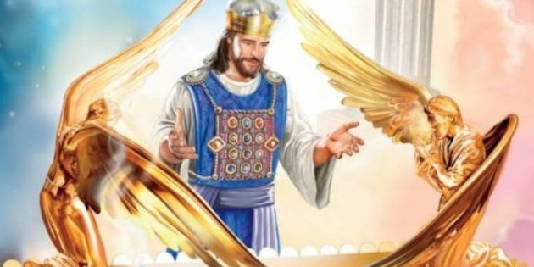
"So Christ has now become the High Priest over all the good things that have come. He has entered that greater, more perfect Tabernacle in heaven, which was not made by human hands and is not part of this created world"
(Hebrews 9:11 NLT).

Slide 28
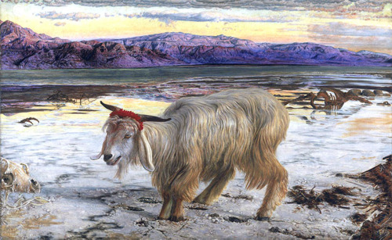
"As the goat goes into the wilderness, it will carry all the people's sins upon itself into a desolate land" (Leviticus 16:22).

Slide 29
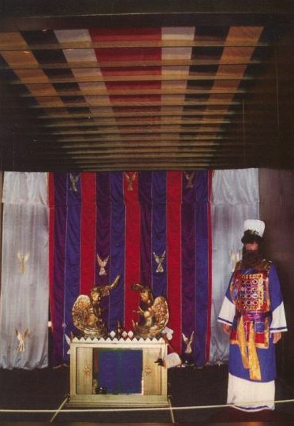
Day of Atonement Symbolism
"When Christ came as high priest of the good things that are already here, he went through the greater and more perfect tabernacle that is not man-made, that is to say, not a part of this creation."
Hebrews 9:11 (NIV)

Slide 30
Once with His Own Blood for All!
"He did not enter by means of the blood of goats and calves; but he entered the Most Holy Place once for all by his own blood, having obtained eternal redemption."
Hebrews 9:12 (NIV)

Slide 31
No More Atonement Needed
"Nor did he enter heaven to offer himself again and again, the way the high priest enters the Most Holy Place every year with blood that is not his own."
Hebrews 9:25 (NIV)

Slide 32
Sin Done Away With (Not Just Covered)
"Then Christ would have had to suffer many times since the creation of the world. But now he has appeared once for all at the end of the ages to do away with sin by the sacrifice of himself."
Hebrews 9:26 (NIV)

Slide 33
A Seat in the Holy of Holies?
"But when this priest had offered for all time one sacrifice for sins, he sat down at the right hand of God."
Hebrews 10:12 (NIV)

Slide 34



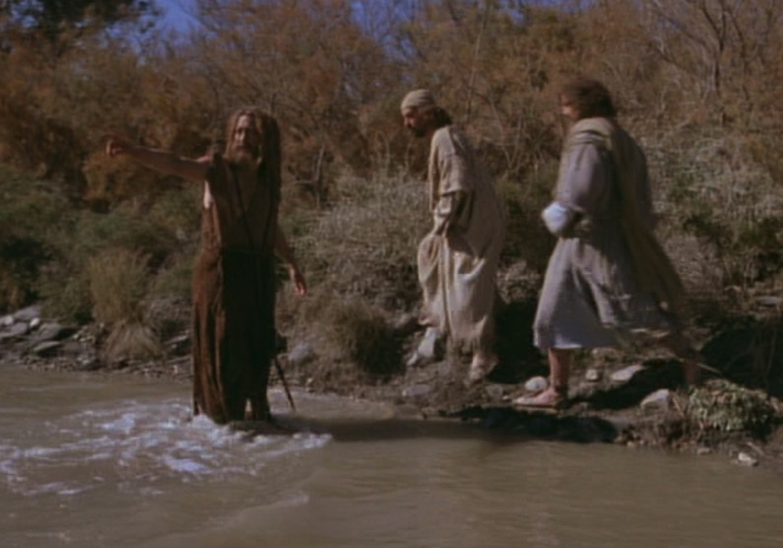
The Passover Lamb
"Look, the Lamb of God,
who takes away
the sin of the world!"
(John 1:29)

Slide 35

Passover Protection
"The blood will be a sign for you on the houses where you are; and when I see the blood, I will pass over you. No destructive plague will touch you when I strike Egypt."
Exodus 12:13 (NIV)

Slide 36
Faith Pictured
"By faith he kept the Passover and the sprinkling of blood, so that the destroyer of the firstborn would not touch the firstborn of Israel."
Hebrews 11:28 (NIV)

Slide 37
The Lamb Pictured
"The next day John saw Jesus coming toward him and said, 'Look, the Lamb of God, who takes away the sin of the world!'"
John 1:29 (NIV)

Slide 38
The Cross Pictured
"For Christ, our Passover lamb, has been sacrificed."
1 Corinthians 5:7 (NIV)

Slide 39

Faith in a Lamb

Slide 40

"This is my body…"

Slide 41

Exodus 12:1-16
The Angel of Death Passed Over Houses with Blood on the Doors
Thus says the LORD, "About midnight I will go out in the midst of Egypt" (Exod. 11:4)

Slide 42
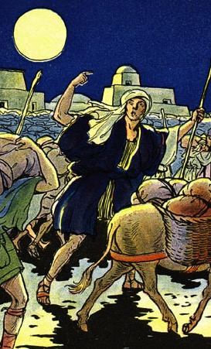
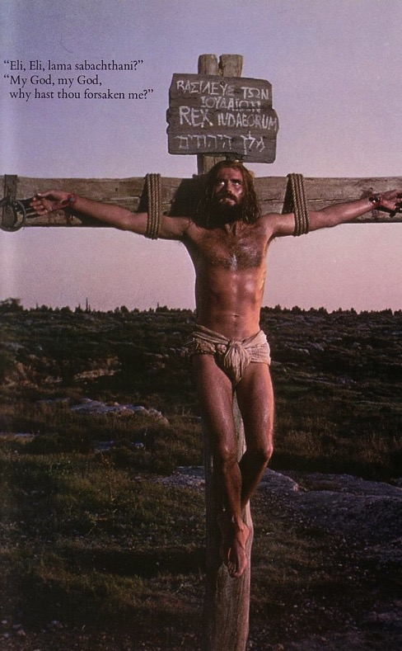
The Common Thread
What the Exodus is to the Old Testament…
the cross of Christ is to the New Testament
Deliverance!

Slide 43
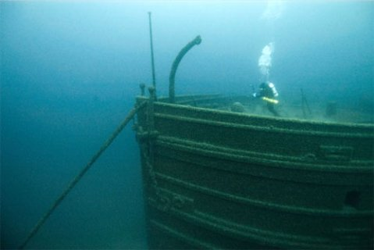
Exploring the Theme
Grab a partner
Each of you paraphrase Romans 1:16-17
Contrast these verses with how you used to think you could be right with God before becoming a Christian
Notes:
----- Meeting Notes (1/24/11 10:16) -----
How does this differ with how a Buddhist seeks to be right with God?

Slide 44

WE NEED TO ATTAIN GOD'S RIGHTEOUSNESS—BUT HOW?

Slide 45
The Theme of Romans
23
¹⁶I am not ashamed of the gospel, because it is the power of God for the salvation of everyone who believes: first for the Jew, then for the Gentile.
¹⁷For in the gospel a righteousness from God is revealed, a righteousness that is by faith from first to last, just as it is written: "The righteous will live by faith."
Don't be ashamed of the gospel because it works! It alone makes us righteous!

Slide 46

Righteousness in Romans
Theme | Needed | Provided | Imparted | Proved | Applied | Dissem-inated
Intro 1:1-17 | Condem-nation 1:18– 3:20 | Justifi-cation 3:21– 5:21 | Sanctifi-cation 6–8 | Election 9–11 | Trans-form-ation 12:1– 15:13 | Propa-gation 15:14– 16:27
Start | Sin | Salva-tion | Set Apart | Sove-reignty | Service | Send

Slide 47

God's Wrath (Romans 1:18-20)
23
151
The Reality (18a)
The Reason (18b-20a)
The Result (20b)

Slide 48
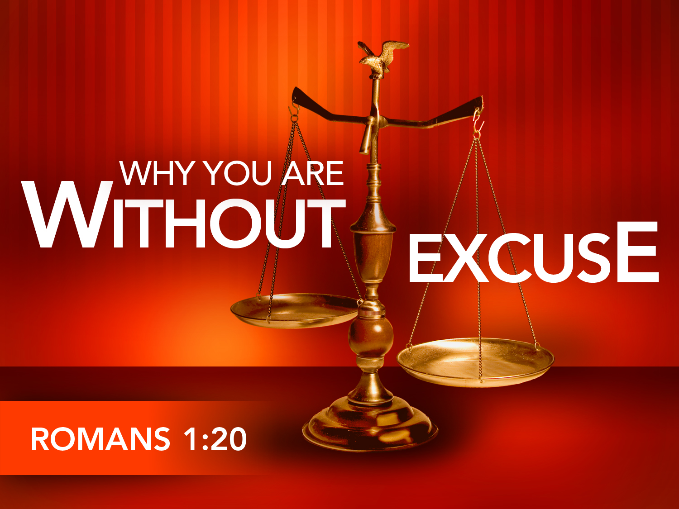

Why You Are Without Excuse (Romans 1:20)
WHY YOU ARE
WITHOUT
EXCUSE
ROMANS 1:20
Notes:
Please translate the text at the left and then drag everything over this slide so no English shows. Make sure the fonts remain.

Slide 49

Romans 1:20
23
161
Person who is Limitless
Person who is Supernatural
For since the creation of the world God's invisible qualities-- his eternal power and divine nature-- have been clearly seen, being understood from what has been made, so that men are without excuse (NIV).
For since the creation of the world God's invisible qualities-- his eternal power and divine nature-- have been clearly seen, being understood from what has been made, so that men are without excuse (NIV).

Slide 50
Romans 1:20
23
161
Since the start of creation…
people have seen God
= literal 24-hour days
For since the creation of the world God's invisible qualities-- his eternal power and divine nature-- have been clearly seen, being understood from what has been made, so that men are without excuse (NIV).
For since the creation of the world God's invisible qualities-- his eternal power and divine nature-- have been clearly seen, being understood from what has been made, so that men are without excuse (NIV).

Slide 51


Why God is Angry at Gentiles
(1:21-32)
23
151
Ignore God (21-23)
God gave them over
Impurity (24)
Idolatry (25)
God gave them over
Homosexuality (26-27)

Slide 52
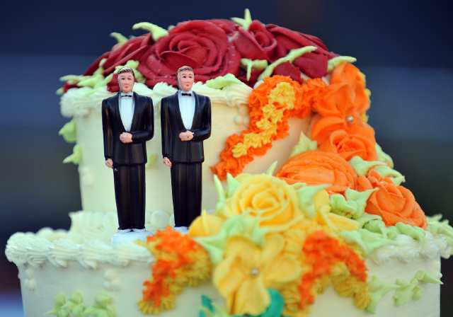
What About Homosexuality?

Slide 53

What About Same Sex "Marriage"?
See Family Research Council (frcblog) on YouTube
Notes:
The link is http://www.youtube.com/watch?v=nPgZ2Mq1Ugw

Slide 54
Why God is Angry at Gentiles
(1:21-32)
23
151
Ignore God (21-23)
God gave them over
Impurity (24)
Idolatry (25)
God gave them over
Homosexuality (26-27)
God gave them over
Depravity (28-32)

Slide 55

All Are Under Sin
^{10b} "No one is righteous—
not even one.
¹¹ No one is truly wise;
no one is seeking God.
¹² All have turned away;
all have become useless.
No one does good,
not a single one (Pss 14:1-3; 53:1-3–Greek version).
¹³ "Their talk is foul, like… stench from an open grave.
Their tongues are filled with lies."
"Snake venom drips from their lips" (Ps 5:9 Gr.; 140:3).
¹⁴ "Their mouths are full of cursing and bitterness" (Ps 10:7 Gr. version).
¹⁵ "They rush to commit murder.
¹⁶ Destruction and misery always follow them.
¹⁷ They don't know where to find peace" (Isa 59:7-8).
¹⁸ "They have no fear of God at all."
  (Rom 3:10b-18 NLT)
23

Slide 56
The Law Won't Save
23
¹⁹ Obviously, the law applies to those to whom it was given, for its purpose is to keep people from having excuses, and to show that the entire world is guilty before God. ²⁰ For no one can ever be made right with God by doing what the law commands. The law simply shows us how sinful we are.
  (Rom 3:19-20 NLT)

Slide 57
Black

Slide 58


Salvation link at BibleStudyDownloads.org
Get this presentation and script for free!

